Slide 1
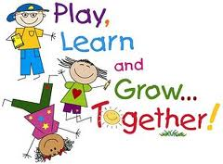
Observations in the Early Childhood Classroom Storyboard
Kristy Cotton
AET/545
Dr. Sean Spear
July 8, 2013

Slide 2
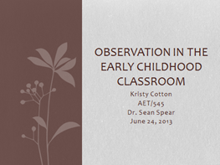
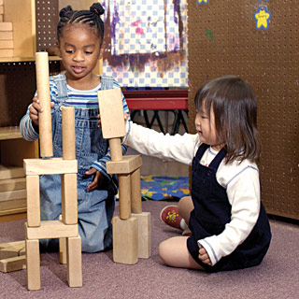
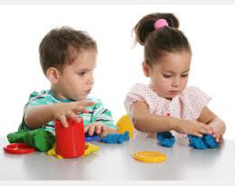
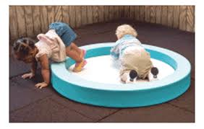
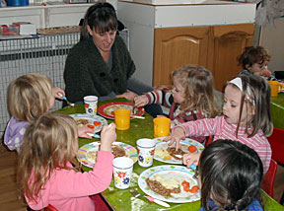
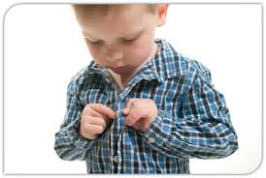
Title: Home
Scene (opening page): Introduction
Slide number: 1
Skill or Concept: Introduction
Animation (yes or no): N
Graphics (yes or no): Y
Audio (yes or no): N
Global Designer Notes: Powerpoint Theme: Flowers, Brown, Candara Font, unless otherwise shown.
Programmer Notes: Provide a menu of links to the following pages:
Pre-test
Looking at videos
Writing your own observations
Extended Activites
Post-test
Provide the appropriate links to all graphics.
Instructional Text and Graphics:
Take the pretest before clicking on any lessons.
Pre-Test Here
Once you have taken the pre-test, you may start the lesson. Remember to complete the lesson prior to taking the post test. Visit assignment page following each lesson and complete the assigned task for that lesson.
Informational Text: Welcome to Observations in the Early Childhood Classroom Tutorial. You are here because you are new to the world of writing observations for early childhood children. We want you to enjoy this experience of writing observations and getting to know your children. This tutorial review only a few of the basic steps in writing a clear and concise observation. This is a foundation for which you can build upon. Please enjoy and if you have any questions please feel free to ask as you go through the tutorial.
Graphics: Each of these graphic will be linked to the appropriate lesson.
Free Play Structure Activities Outdoor/Gross Motor Meal Time Self-Care
Notes:
Learners will be able to click on any lesson. No specific order is required.
References for graphics:
Stop sign: Office 2010 Clip Art.
Free Play: Retrieved from www.pinehill.org
Structured Activities: Retrieved from www.galilee.org
Outdoor/Gross Motor: Retrieved from www.safespaceconcepts.com
Meal Times: Retrieved from www.poppiechildrennursery.co.uk
Self-Care Practices: Retrieved from www.kidbility.com

Slide 3
Title: Pre-test
Scene: Pre-test prior to any lesson
Slide number: 2
Skill or Concept: Pre-knowledge assessment
Animation (yes or no): N
Graphics (yes or no): N
Audio (yes or no): N
Designer Notes: Maintain theme. Black, Candara Font Align Test box to left margin
Programmer Notes: Link this page to Pre-Test Here on home page. Embed the 10 sample observations assessment in the tutorial.
Instructional Text: We want to see how much you already know. Please complete this non graded 10 question pre-test prior to completing any lesson. You will write correct if the observation is clear, you will write No is the observation is not clear.
Timmy goes down the slide by himself then hops up and uses stairs alternating his feet to do it again.
Shawn play with playdough.
The child flapped his arms when the car reached the bottom of the tower.
The child is crying.
John ate corn and macaroni using his fork and spoon while sitting at the table.
Two children were rolling their cylinders across the table repeatedly to see whose would go the furthest.
The child was cheering on his friend while they were rolling cylinders across the table during small group time.
The child was using rolling pin with playdough.
The little girl washed her hand in the sink.
Sally went to the bathroom, when she finished she pulled up her pants by herself and then went to the sink to wash her hands and then dried them with a paper towel.
Notes:
The first post-test results will be compared to the pre-test as part of the tutorial summative assessment.

Slide 4
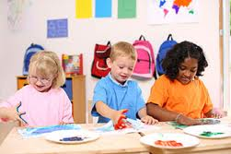
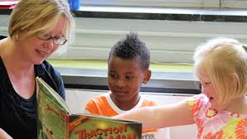
Title: Writing the Observation
Scene: Writing a Clear Observation
Slide number: 3
Skill or Concept: Writing and Observation from a picture
Animation (yes or no): N
Graphics (yes or no): Y
Audio (yes or no): N
Designer Notes: Place instructional graphics in line with text. Place photos with non-clear written observations. Place discussion forum at bottom of page.
Programmer Notes: Create a section with graphics and with clear written observations.
Informational Text: One of the first things we teach first year teachers is how to look at their children in their classroom and find opportunities where teachable moments or skills that have been successfully completed. Non-clear observations can be hard for Instructional Coaches to understand and makes it harder for you to plan. The purpose of this lesson is to teach you how to write a clear and concise observation. Examples of non-clear observations based on the pictures shown.
The children are using their hands. The teacher is holding a book.
Instructional Text and Graphics: Look at the pictures given to you. Each of the previous observations told us what we see in the picture but the observation was not clear and concise on what was actually happening or what they were trying to tell us. Here are the two pictures again with the clear observation to go with it.
The children are using The children are
their hands to paint a pointing to the
picture using different pictures in the book
color paint. while the teacher holds it.
For Discussion: When should you write and observation?
Next
Notes:
Photo References:
Children painting: Retrieved from www.ttacnew.vcu.edu
Teacher hold book: Retrieved from www.coursera.org

Slide 5
Title: Observation Activities
Scene: Required activities to assess knowledge
Slide number: 4
Skill or Concept: Writing and Observation from a picture
Animation (yes or no): N
Graphics (yes or no): N
Audio (yes or no): N
Designer Notes: Clearly separate activity instructions, and place in bold type.
Programmer Notes: Link this page to the arrow
on Writing Observations page
Informational Text: It is important to know how to properly write a clear and concise observation before you go into the early childhood classroom. You may have many opportunities to find an observation in the classroom so it is important to know how to write a clear observation based on what you have seen.
Instructional Text and Graphics:
Observation Activities
Create a word document with three photos of children doing one of these activities: free play, gross motor and structured activities. Document your sources. Write a clear observation based on what you see in the photo. Email to: instructionalcoach@earlychildhoodcenter.com
Find a video from youtube of children do self-care practices. Write an observation based on what you saw in the video. Once you have finished the Instructional Coach will come to see the video you have chosen and then look at the observation you have written. The instructional coach will place a “c” by your name if the observation is clear and concise.
Next
Notes:
These two activities will serve as formative assessment. The photo activity needs to be completed with 95% accuracy. The video activity is required to be performed with 100% accuracy.

Slide 6
Title: Post-test
Scene: Final Assessment
Slide number: 5
Skill or Concept: Assessment
Animation (yes or no): N
Graphics (yes or no): N
Audio (yes or no): N
Designer Notes: Maintain theme. Black, Candara Font Align Test box to left margin
Programmer Notes: Link this page to “Test” in the menu on the home. Embed the 10 sample observations assessment in the tutorial.
Instructional Text: We want to see how much you already know. Please complete this non graded 10 question pre-test prior to completing any lesson. You will write correct if the observation is clear, you will write No is the observation is not clear.
Timmy goes down the slide by himself then hops up and uses stairs alternating his feet to do it again.
Shawn play with playdough.
The child flapped his arms when the car reached the bottom of the tower.
The child is crying.
John ate corn and macaroni using his fork and spoon while sitting at the table.
Two children were rolling their cylinders across the table repeatedly to see whose would go the furthest.
The child was cheering on his friend while they were rolling cylinders across the table during small group time.
The child was using rolling pin with playdough.
The little girl washed her hand in the sink.
Sally went to the bathroom, when she finished she pulled up her pants by herself and then went to the sink to wash her hands and then dried them with a paper towel.
Notes:
The first post-test results will be compared to the pre-test as part of the tutorial summative assessment.

